Slide 1
CC1X06 DIGITAL COMMUNICATION FOR IMPACT
CA2 Team Template
[DCPE/FT/1B/05]
Toh Bao Yi (2204509)
Toh Min Hao(2223867)
Kimberly Mallari (2224264)

Slide 2
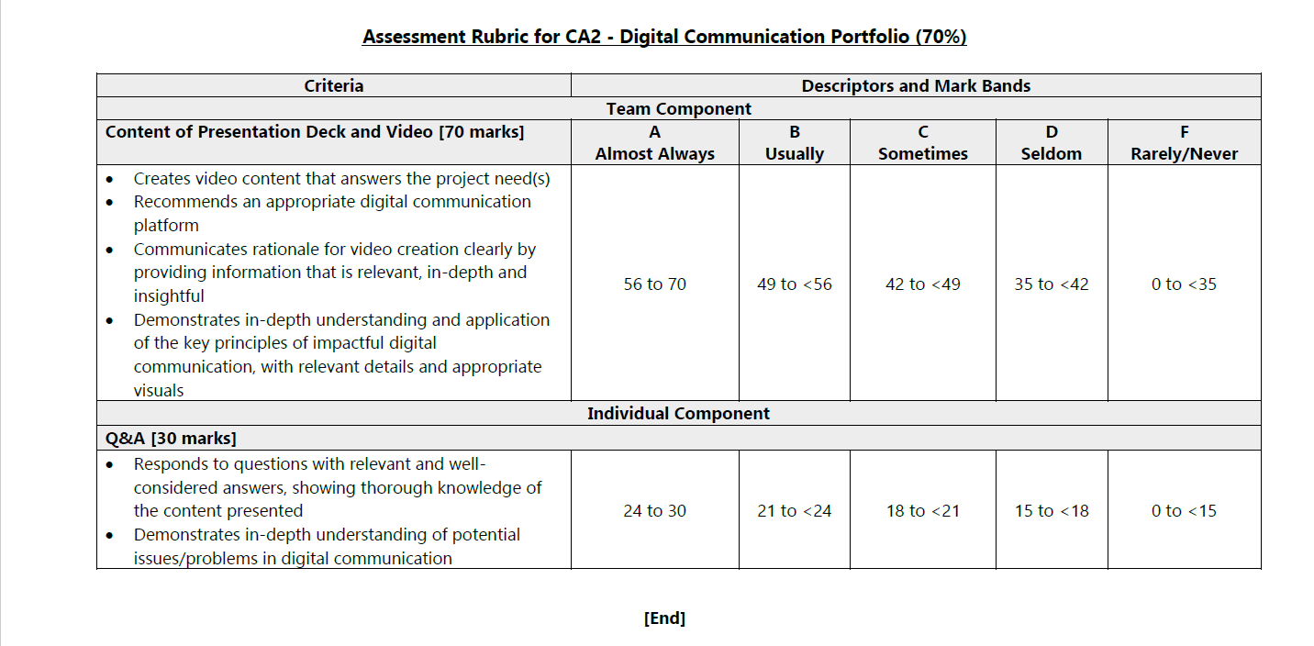

Slide 3
Overview of CA2 Presentation
Choice of Social Media Platform
Video Content (PAC)
The AIDA Framework
Final Video
Q&A
Note: Your team’s presentation (points 1-4) should not take up more than 10 minutes.

Slide 4

1. Social Media Platform
Our team's choice of digital communication platform is Youtube (video), because Youtube has a wide user space of more than 2.6 billion active users( DemandSage,2023)
Pros:
-Can easily comment and as the creator we can see the comments and feedback from potential buyers.
-It is easy and free to post on Youtube as all you need is an account.
Cons:
-As a new startup company, it is likely that little to no users will see our videos at first due to Youtube algorithm.
-Similar products may be advertised on our Youtube video drawing potentional clients away from us.

Slide 5

2. Video Content (PAC)
PURPOSE
To convince the audience that our autonomous vehicle will help to reduce the workload of workers, increase productivity and boost revenue, the warehouse managers will be encouraged to buy our product.
AUDIENCE
Warehouse management team who wish to see a boost in productivity in their warehouse as well as employees who are tired of being overworked.
CONTEXT
Achieve higher levels of economic productivity through diversification, technological upgrading and innovation, including through a focus on high-value added and labor-intensive sectors. Many warehouse are resigning due to poor work conditions.

Slide 6
2. Video Content (PAC)
Hashtags
#AutonomousVehicle #robot #innovation #auto #warehouse #launchsale
Explain how your content and the associated text and hashtags will meet the purpose stated.
By explaining the benefits of the Autonomous Vehicle, it will encourage them to adopt it because it will appeal to their needs. Since robots are a trending topic the hash tags will increase the number of impressions on our video and hence reach a wider audience. People searching for autonomous vehicle and robots will get recommended this video. By promoting the low price point of our vehicle, it will attract more buyers to adopt our product. Furthermore, there will be a launch sale to create a sense of urgency to buyer who do not want to miss out.

Slide 7

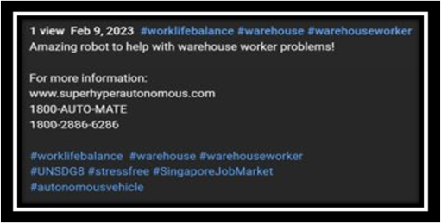
3. The AIDA framework
A: Awareness
By using popular social media platform as well as trendy hash tags, we create awareness to our video. Using attention grabbing headline like “BOOST PRODUCITIVY TODAY WITH OUR VEHICLE! REVENUE BOOST GURANTEED!!!” by using all caps and many exclamation mark title it grab attention
#warehouse #worklifebalance #UNSDG8 help attract the target audience and make them aware that the video targets their workplace issues.
I: Interest
We create interest by highlighting the problem of overworked workers who are quitting due to stress which will get the management to empathize as they likely face similar issues within their company

Slide 8
3. The AIDA framework
D: Desire
We create desire in the management of the warehouse who is likely keen to not only reduce their manual workload but also increase their profits
A: Action
Finally, we have a call to action by encouraging the audience to adopt our vehicles right now as we having a launch discount for a limited time. “call this number to speak to our sales team”

Slide 9

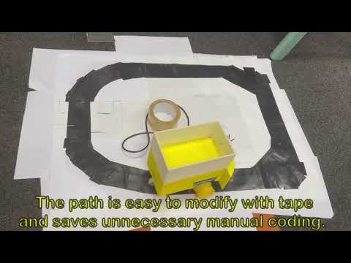
4. Final Video
LINK: https://youtu.be/wuvxk2stlWU

Slide 10


Slide 11
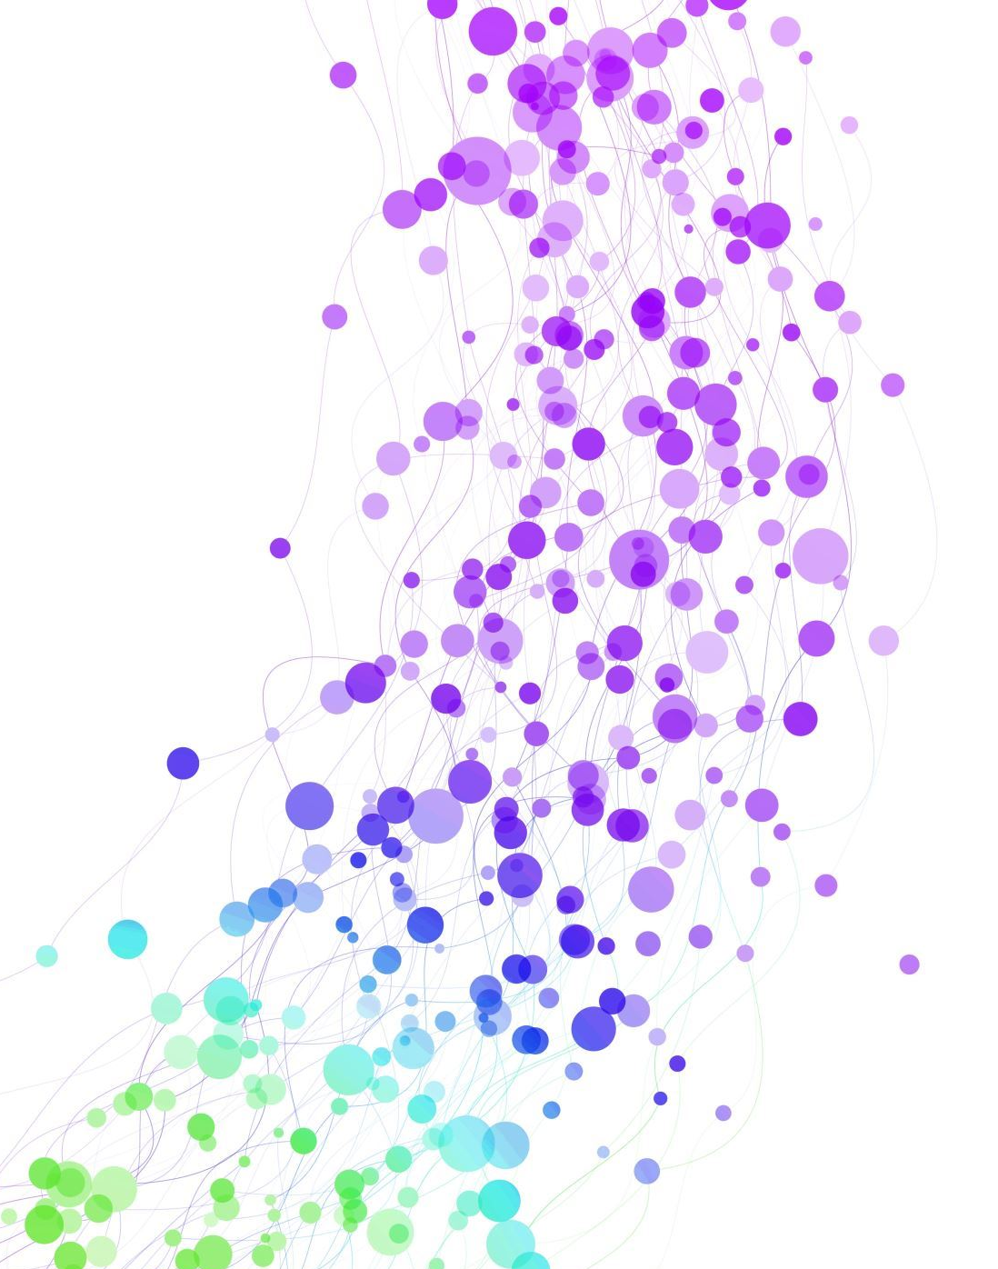
Thank you! All groups are to submit their CA2 Team Template and Video to their lecturer at the start of Lesson 6. Your lecturer will advise you on their preferred mode of submission.

Slide 12
References
Ruby, D. and About The Author Daniel Ruby Content writer with 10+ years of experience. I write across a range of subjects (2023) YouTube statistics (2023) - updated data, Facts & figures shared!, Demand Sage. Available at: https://www.demandsage.com/youtube-stats/ (Accessed: February 9, 2023).

